Slide 1
DRIVER DROWSINESS DETECTION
Ayşenur YILMAZ
Mustafa Abdullah HAKKOZ
Mahmut AKTAŞ
Advisor: Prof. Dr. Çiğdem EROĞLU ERDEM

Slide 2
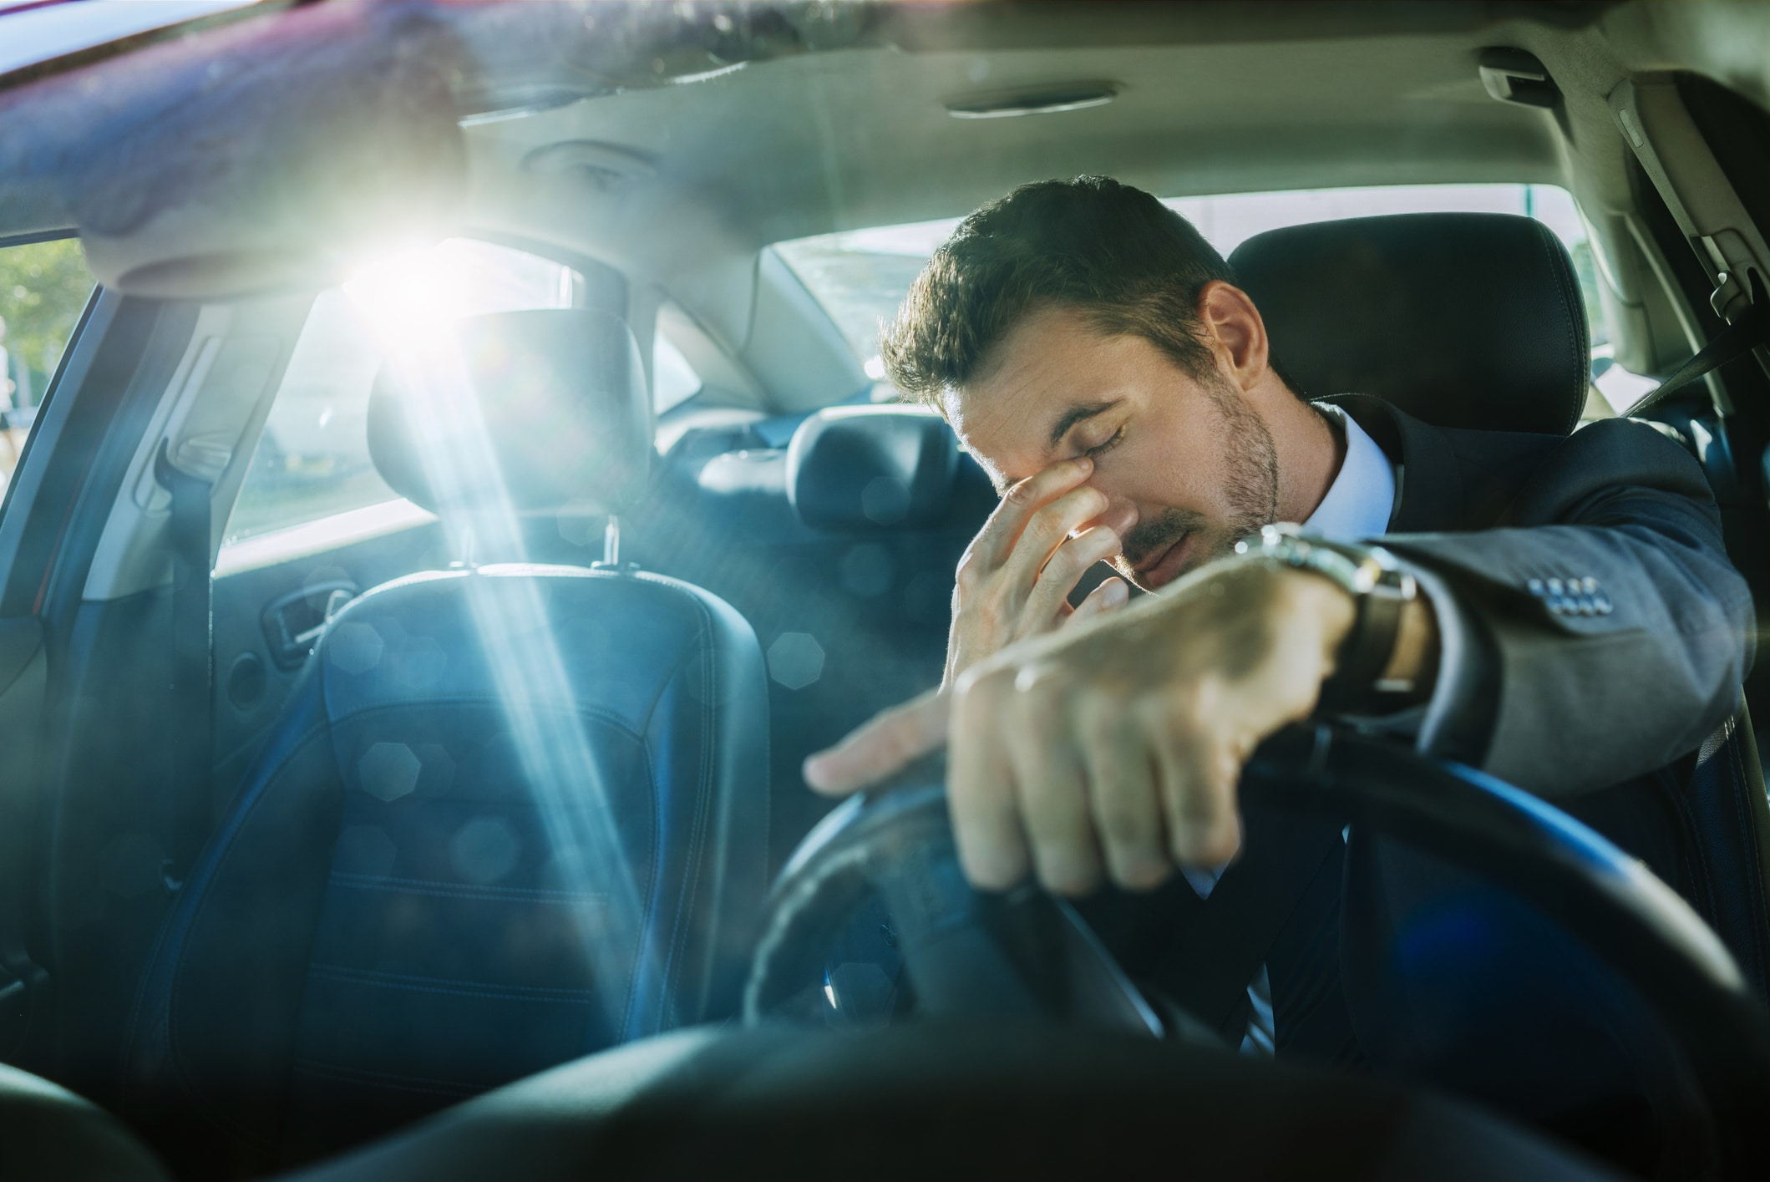
Problem Statement
According to the KGM¹, last year 3704 people have died in road accidents in Turkey and 92.65% of accidents were caused by driver defects ^{[1].}
Development of a robust and practical drowsiness detection system is a crucial
Our aim is to make a system that detects drowsiness status of the driver based on facial behaviors.
¹KGM:Karayolları Genel Müdürlüğü

Slide 3




Aims
Detecting Driver Drowsiness with High Accuracy
Early Detection
Real-Time Performance
Adaptivity to the Subject
At least a 65% accuracy rate
Predicting drowsiness 1-2 sec ago
Works fast enough with maximum delay of 2 sec
Available for different physical characteristics

Slide 4
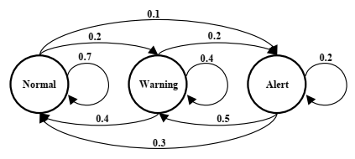
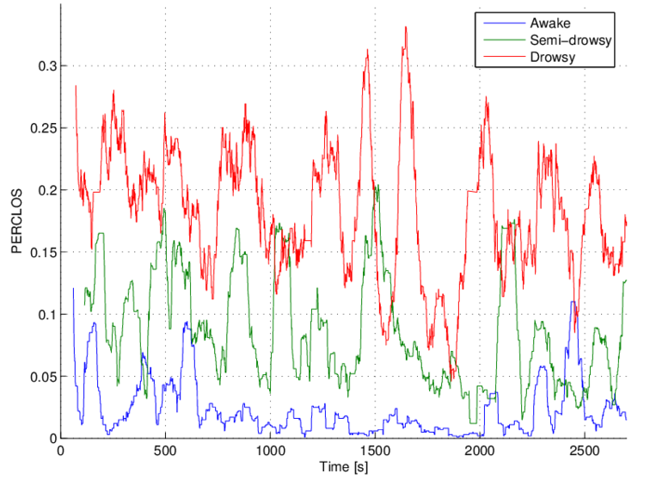
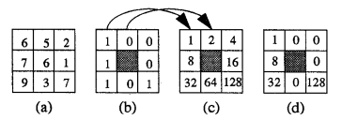
Related Work
Driver Drowsiness Detection Through HMM Based Dynamic Modeling (Tadesse et al., 2014) [2]
HMM vs Single Frame Method
HMM gives higher accuracy
A Practical Driver Fatigue Detection Algorithm Based on Eye State (Liu et al., 2010) [3]
PERCLOS(Percentage of Eye Closure)
NTHU dataset
Accurate Fatigue Detection Based on Multiple Facial Morphological Features (Li et al., 2019) [4]
LBP(Local Binary Pattern)
A Realistic Dataset and Baseline Temporal Model for Early Drowsiness Detection (Ghoddoosian et al., 2019) [5]
Dlib
Blink Features with HM-LSTM

Slide 5
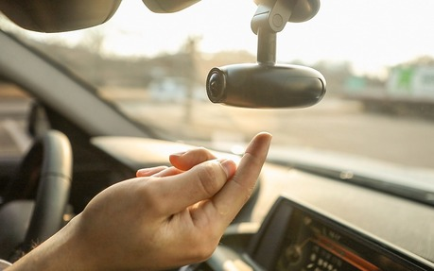
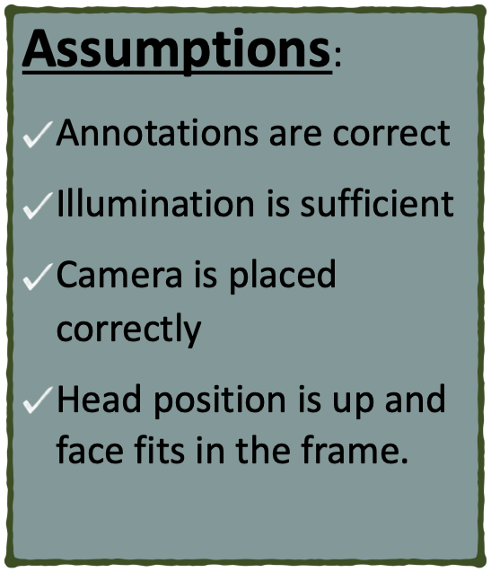
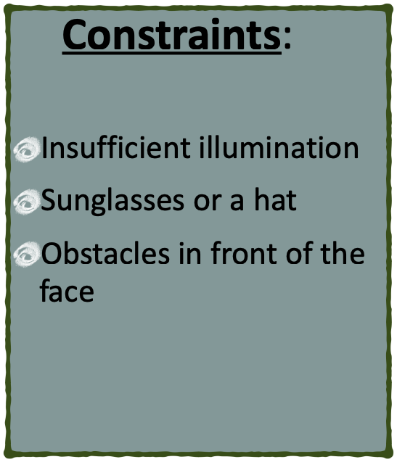
Scope: Assumptions and Constraints

Slide 6
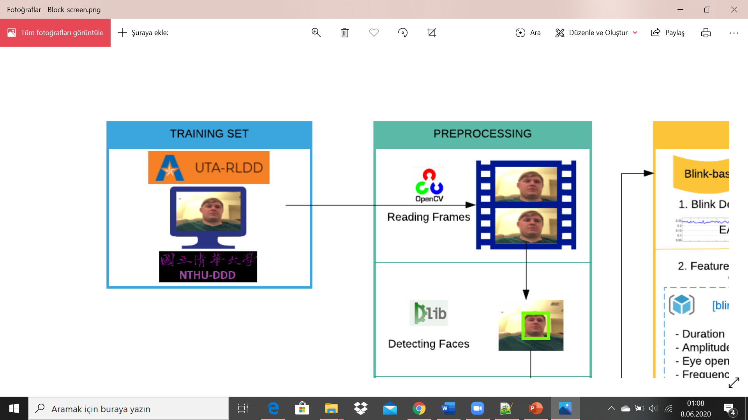
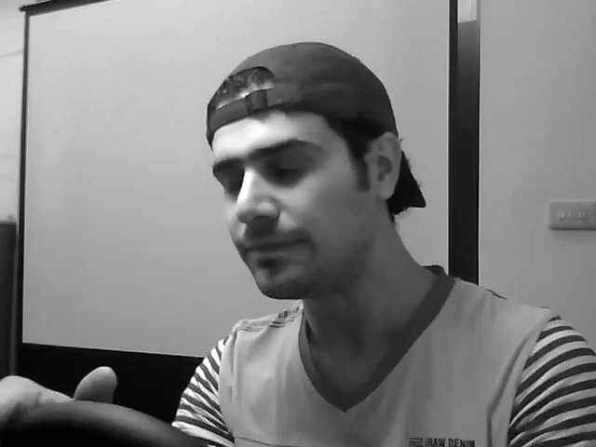


Dataset Specifications
UTA Real Life Drowsiness Dataset:
University of Texas at Arlingto
60 people, 180 videos, 30 hour
Several ethinicities
Realistic videos
Only video labels are provided: alert, low vigilant and drowsy
NTHU Diver Drowsiness Dataset:
National Tsing Hua University
36 people, 90 videos, 10 hours
Several ethinicities
Acting videos
Only frame labels are provided: 0, 1 for eye closeness, nodding and yawning
A sample video from NTHU dataset

Slide 7
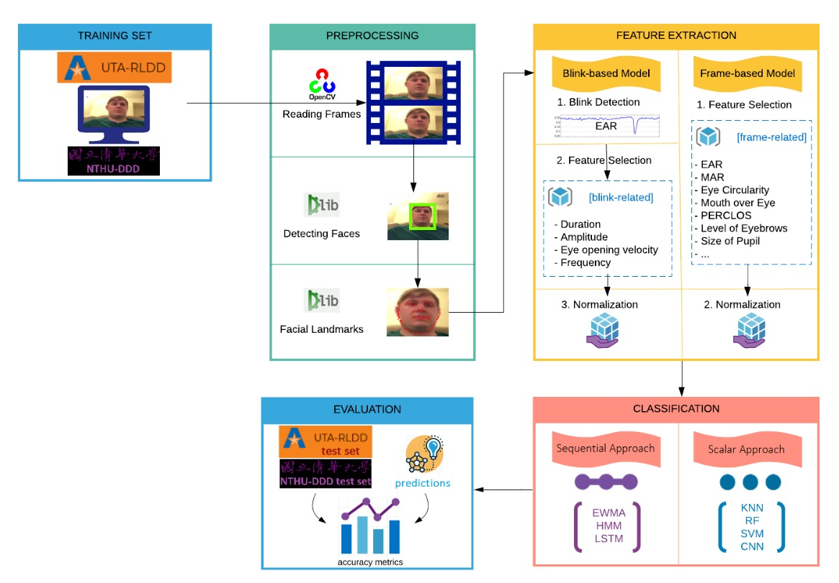
Methodology:
Conceptual
Diagram

Slide 8

Processing Videos
Implementation of the project starts with Processing Videos Phase which includes steps;
1) Reading Video Frames
Either can be done from a dataset or a camera in a real-time manner.
For this step, opencv-python is used.

Slide 9
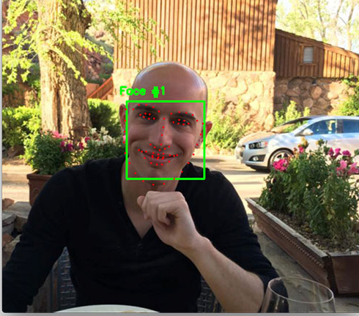
Processing Videos
Implementation of the project starts with Processing Videos Phase which includes steps;
2) Detecting Faces
Dlib’s get_frontal_face_detector method
Pre-trained “Histogram of Oriented Gradients + Linear SVM”

Slide 10
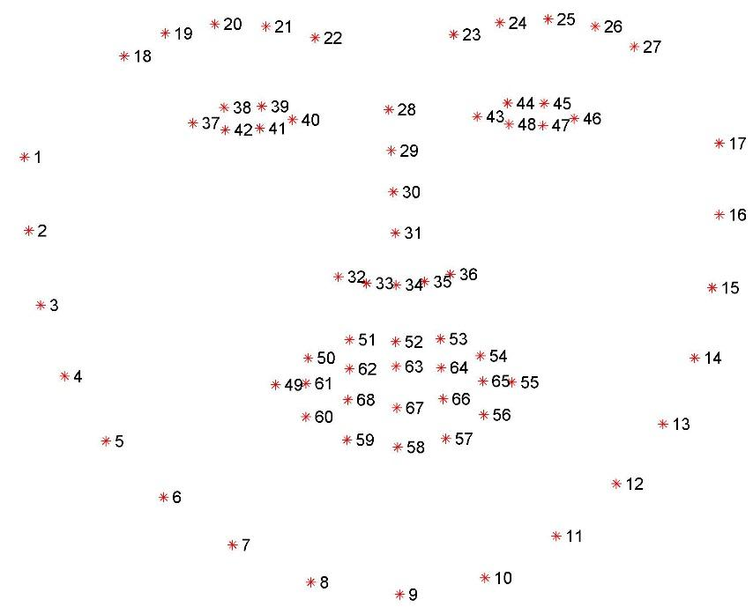
Processing Videos
Implementation of the project starts with Processing Videos Phase which includes steps;
3) Predicting Facial Landmarks
Dlib’s shape_predictor method
Pre-trained model of an ensemble of regression trees to predict 68 facial landmarks
All of the features will be used in later phases, are extracted from these positional landmarks.

Slide 11
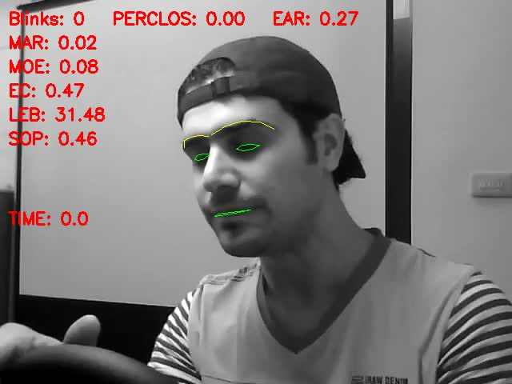
Processing Videos

Slide 12
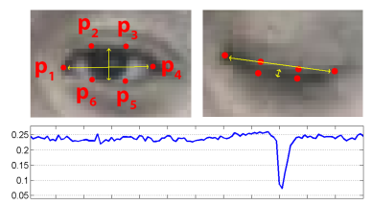
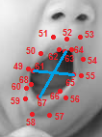


Feature Extraction Phase: Frame-based
Eye Aspect Ratio (EAR):
Mouth Aspect Ratio (MAR):
$$EAR(i)= \frac{‖p_{2}−p_{6}‖+‖p_{3}−p_{5}‖}{2‖p_{1}−p_{4}‖},$$
$$MAR(i)= \frac{‖p_{63}−p_{67}‖}{‖p_{61}−p_{65}‖}$$

Slide 13
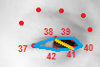


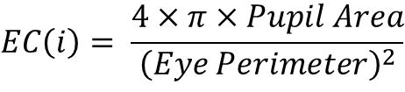
Feature Extraction Phase: Frame-based
Eye Circularity(EC):
$$EC\left(i\right)= \frac{4×π×Pupil Area}{{\left(Eye Perimeter\right)}^{2}}$$
$$Pupil Area= {\left(\frac{‖p_{38}−p_{41}‖}{2}\right)}^{2}×π$$
$Eye Perimeter= ‖p_{37}−p_{38}‖+‖p_{38}−p_{39}‖+‖p_{39}−p_{40}‖+$ $‖p_{40}−p_{41}‖+‖p_{41}−p_{42}‖+‖p_{42}−p_{37}‖$

Slide 14

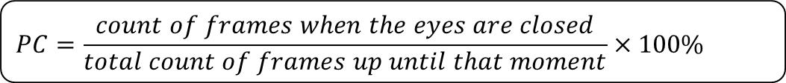
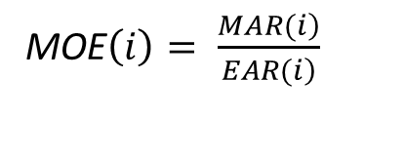
Feature Extraction Phase: Frame-based
PERCLOS:
Mouth over Eye(MOE):
MOE$\left(i\right)= \frac{\left.MAR(i\right)}{\left.EAR(i\right)}$

Slide 15
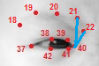
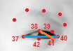


Feature Extraction Phase: Frame-based
Level of Eyebrow(LEB):
Size of Pupil(SOP):
$$LEB(i)= \frac{‖p_{21}−p_{40}‖+‖p_{22}−p_{40}‖}{2}$$
$$SOP(i)= \frac{‖p_{38}−p_{41}‖}{‖p_{37}−p_{40}‖}$$

Slide 16
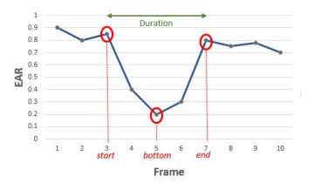
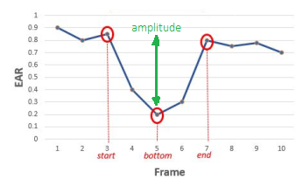

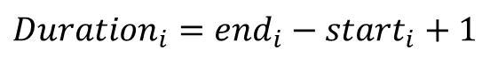
Feature Extraction Phase: Blink-based
All of the features are calculated just for deteceted blinks in the video and will be handed into the classifier.
Duration:
Amplitude:
$${Duration}_{i}={end}_{i}−{start}_{i}+1$$
$${Amplitude}_{i}=\frac{{EAR(start}_{i})−2EAR({bottom}_{i})+EAR({end}_{i})}{2}$$

Slide 17
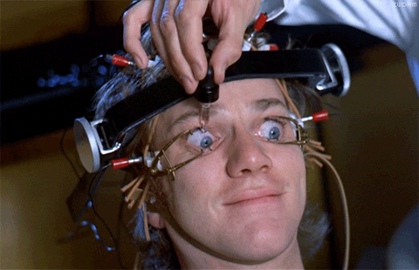

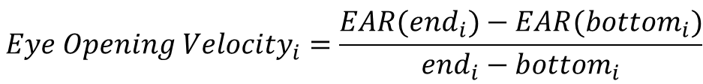
Feature Extraction Phase: Blink-based
All of the features are calculated just for deteceted blinks in the video and will be handed into the classifier.
Eye Opening Velocity:
Frequency:
$${Eye Opening Velocity}_{i}=\frac{{EAR(end}_{i})−EAR({bottom}_{i})}{{end}_{i}−{bottom}_{i}}$$
$${Frequency}_{i}=100×\frac{number of blinks up to {blink}_{i}}{number of frames up to {end}_{i}}$$

Slide 18
Task Accomplished
FRAME-BASED METHOD on NTHU-DDD
Construct DataFrame
Extract feautres
Annotate with ground truth values
Preprocessing
Subject-wise normalization
Column-wise normalization
Feature Importances with Random Forest
ML Classification
kNN, Naive Bayes, Decision Tree
BLINK-BASED METHOD on EyeBlink8+TalkingFace [8]
Blink Detection Techniques
Simple thresholds
Adaptive thresholds
SVM model

Slide 19
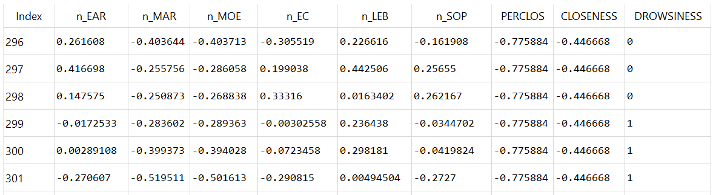
Dataframe and Features
A small sample of the DataFrame

Slide 20



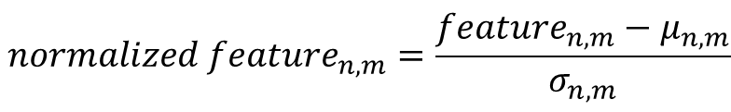
Normalization
Subject-wise Normalization
$μ$and $σ$→ first 90 frames of alert videos for each subject
Column-wise Normalization
$μ$ and $σ$ → for each feature
$${normalized feature}_{n,m}=\frac{{feature}_{n,m}−μ_{n,m}}{σ_{n,m}}$$
$${scaled feature}_{n}=\frac{{feature}_{n}−μ_{n}}{σ_{n}}$$

Slide 21
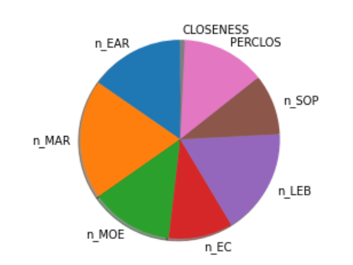
Preliminary Experiments Results
 |  | Non-Scaled (only subject-wise) | Scaled (subject+column)
Decision Tree | Accuracy | 0.7276 | 0.7298
 | AUC | 0.7194 | 0.7214
 | F-1 | 0.77 | 0.77
Naive-Bayes | Accuracy | 0.5598 | 0.5595
 | AUC | 0.5947 | 0.5595
 | F-1 | 0.51 | 0.51
K-nearest Neighbor | Accuracy | 0.7079 | 0.7374
 | AUC | 0.6961 | 0.7258
 | F-1 | 0.75 | 0.78
Random Forest | Accuracy | 0.7894 | 0.7903
 | AUC | 0.7824 | 0.7829
 | F-1 | 0.82 | 0.82
Dataset
NTHU-DDD
Classification
Frame-based Model
Feature Importance
Random Forest + Permutation Importance

Slide 22
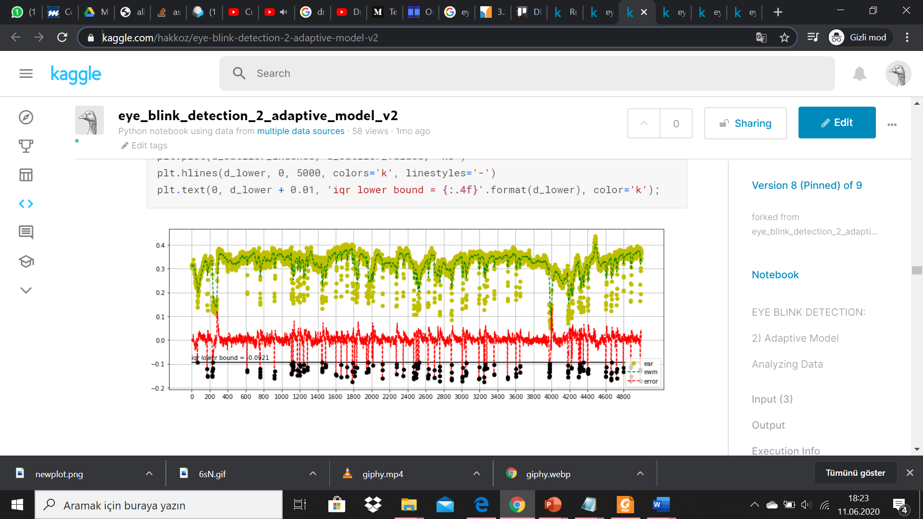
Blink-based Model: Blink Detection
Simple Thresholding [11] :
EAR_THRESHOLD = 0.21
EAR_CONSEC_FRAMES = 3
SKIP_FIRST_FRAMES = 0
Adaptive Thresholding [12] :
EAR_THRESHOLD: EWMA + outlier detection
EAR_CONSEC_FRAMES: PACF, Gridsearch + ARIMA
SKIP_FIRST_FRAMES: Slope of linear fitting.
Support Vector Machine [13] :
training set → eyeblink8 (71260 frames) test set→ talkingFace (5000 frames)
(n x 13) matrix → 13 frame window (6 previous frames + current frame + 6 next frames).
Pipeline → 10-fold CV + gridsearch
best parameters → (C: 10, 'class_weight': None, 'gamma': 'scale', 'kernel': 'rbf', 'max_iter': 5000 )

Slide 23
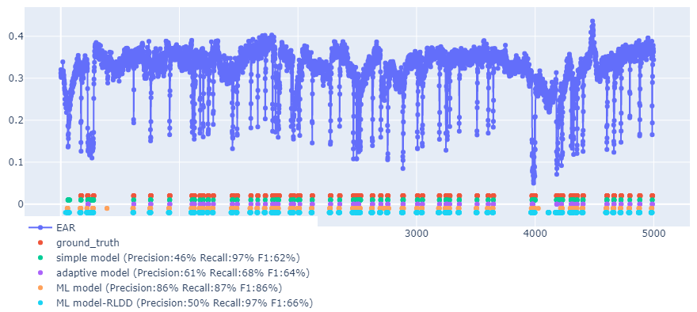
Blink-based Model: Comparison of Blink Detection techniques [14]

Slide 24
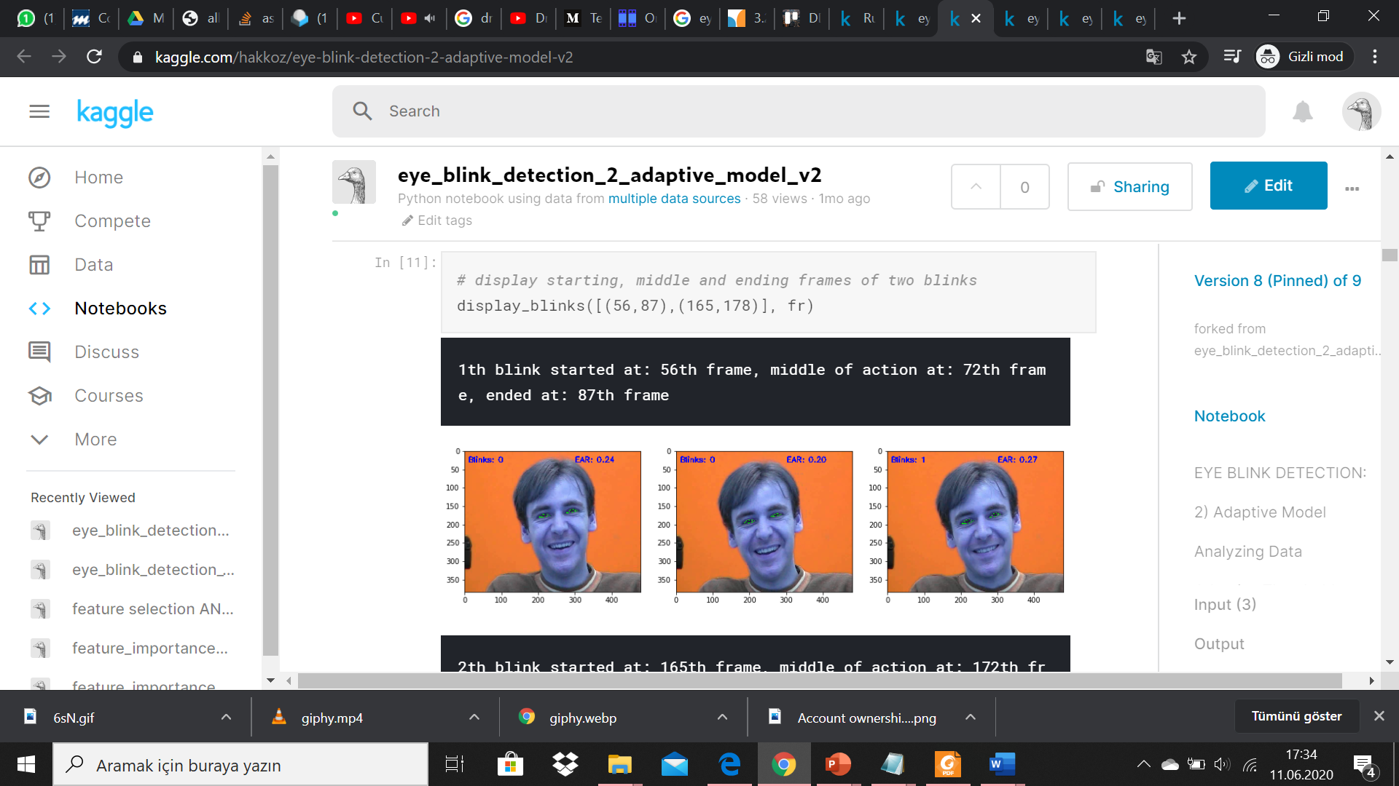
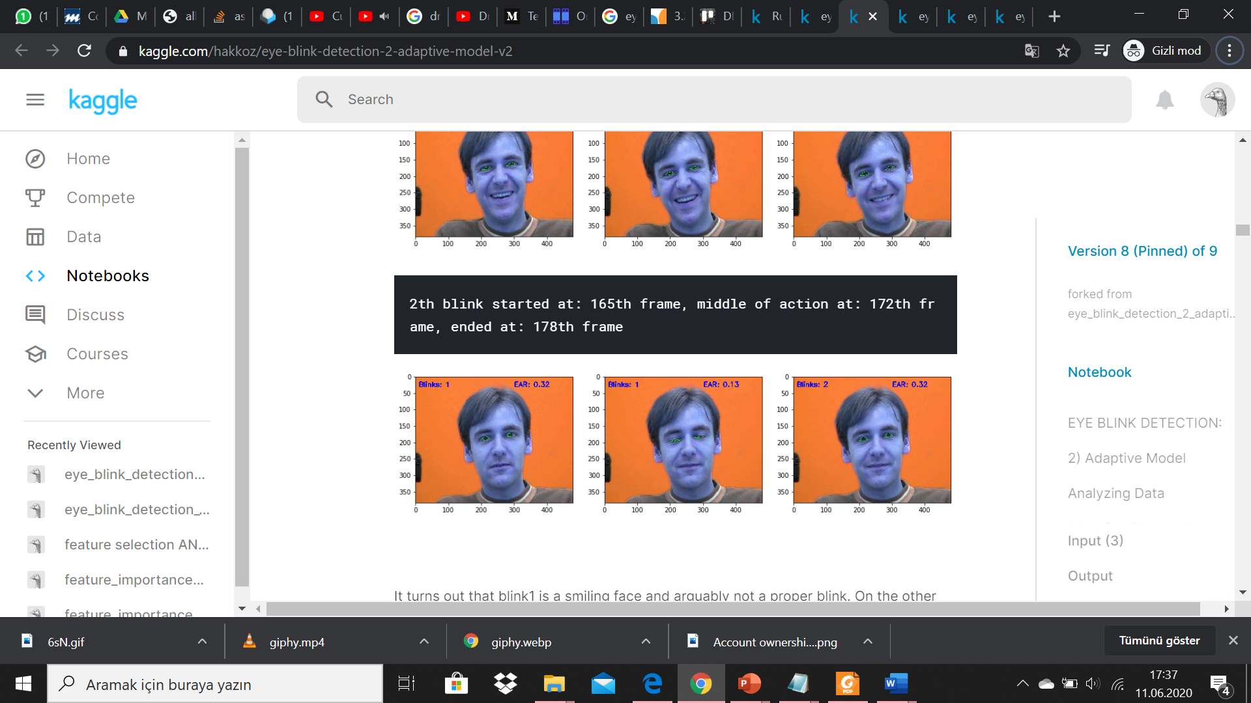
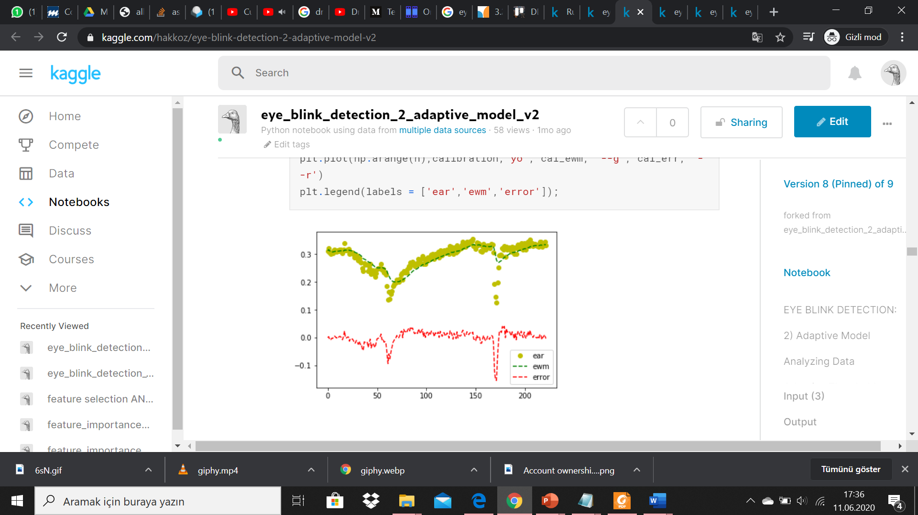
Difficulties Encountered
FRAME-BASED METHOD
While processing videos and constructing the dataframe, following frames are discarded:
Multiple faces and no face detected
Time lapses
Mismatching annotations (First two frames of NTHU-test)
While preprocessing;
Unconsistent thresholding for different subjects: Subject-wise normalization
While calculating feature importances;
Unexpectedly high values for some features: Column-wise normalization
BLINK-BASED METHOD
False blink behaviours like smiling: EWMA

Slide 25
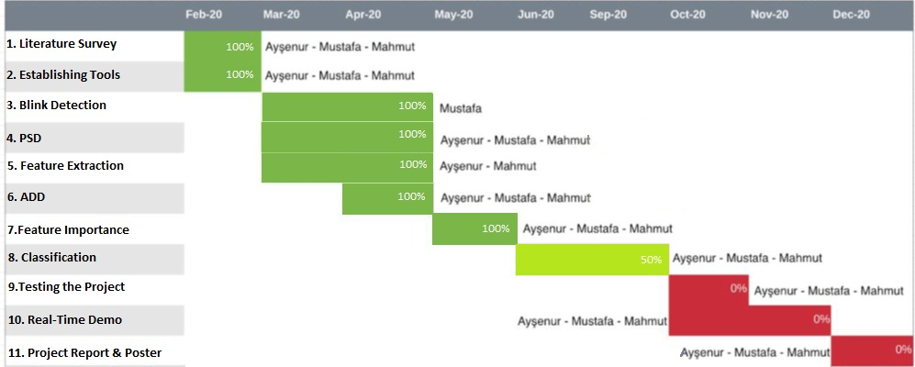
Agenda: GANTT Chart

Slide 26
Tasks to be completed in 2nd semester
FRAME-BASED METHOD
Sequential models(HMM, LSTM),
Head Movements and Texture-based features
BLINK-BASED METHOD
Implementation
Evaluation
Classification
Ensembling
Real-time
Performance optimizations
Simple demo

Slide 27

thank you for listening :)

Slide 28
References
[1] 1-Hartman, K. and J. Strasser, Saving Lives ThroughAdvanced Vehicle Safety Technology:Intelligent Vehicle Initiative Final Report. 2005,Department of Transportation: Washington, DC.
[2] E. Tadesse, W. Sheng and M. Liu, "Driver drowsiness detection through HMM based dynamic modeling," 2014 IEEE International Conference on Robotics and Automation (ICRA), Hong Kong, 2014, pp. 4003-4008.
[3] A. Liu, Z. Li, L. Wang and Y. Zhao, "A practical driver fatigue detection algorithm based on eye state," 2010 Asia Pacific Conference on Postgraduate Research in Microelectronics and Electronics (PrimeAsia), Shanghai, 2010, pp. 235-238.
[4] Li, Kangning et al. “Accurate Fatigue Detection Based on Multiple Facial Morphological Features.” J. Sensors 2019: 7934516:1-7934516:10, 2019.
[5] R. Ghoddoosian, M. Galib and V. Athitsos, A Realistic Dataset and Baseline Temporal Model for Early Drowsiness Detection, in: IEEE/CVF Conference on Computer Vision and Pattern Recognition Workshops (CVPRW), 2019.
[6] UTA-RLDD, UTA Real-Life Drowsiness Dataset. [Online]. Available: https://sites.google.com/view/utarldd/home (Date of Access 20 / 04 /2020)
[7] Computer Vision Lab, National Tsuing Hua University, Driver Drowsiness Detection Dataset. [Online]. Available: http://cv.cs.nthu.edu.tw/php/callforpaper/datasets/DDD/ (Date of Access 20 / 04 /2020)

Slide 29
References
[8] Blink Matters, Research. [Online]. Available: https://www.blinkingmatters.com/research (Date of Access 11 / 06 /2020).
[9] Driver Drowsiness Detection, Github Repository. [Online]. Available: https://github.com/Aysenuryilmazz/Driver_Drowsiness_Detection/blob/master/20_models_v2.py (Date of Access 11 / 06 /2020).
[10] Feature Importances Implementation, Kaggle Notebook. [Online]. Available: https://www.kaggle.com/hakkoz/feature-importances-wrf (Date of Access 11 / 06 /2020).
[11 eye_blink_detection_1_simple_model, Kaggle Notebook. [Online]. Available: https://www.kaggle.com/hakkoz/eye-blink-detection-1-simple-model (Date of Access 11 / 06 /2020).
[12] eye-blink-detection-2-adaptive-model, Kaggle Notebook. [Online]. Available: https://www.kaggle.com/hakkoz/eye-blink-detection-2-adaptive-model-v2 (Date of Access 11 / 06 /2020).
[13] eye-blink-detection-3-ml-model-part2, Kaggle Notebook. [Online]. Available: https://www.kaggle.com/hakkoz/eye-blink-detection-3-ml-model-part2 (Date of Access 11 / 06 /2020).
[14] eye_blink_detection_4_comparison, Kaggle Notebook. [Online]. Available: https://www.kaggle.com/hakkoz/eye-blink-detection-4-comparison (Date of Access 11 / 06 /2020).

